Slide 1

PROJECT REPORT
TOPIC:
DESIGN WEBSItE FOR DuRABLE FURNTURES (DURABLE)
Instructor: Tran Van Diep
Group: Number 3
Leader: Pham Minh Quang
Member: Nguyen Duc Manh
Nguyen Van Dac

Slide 2
Website Overview
Home Page
All Brands Page
Brand Page
Room Page
Our Story
Contact Us
1
2
3
4
5
6

Slide 3
Purpose Of The Subject
Website development for customers with the purpose :
Sell a variety of different furniture.
Friendly interface.
Easy to buy products.

Slide 4
Implementation Environment
HTML/ CSS/ JS
Bootstrap/ Jquery
Sublime Text
Google Chrome/ Internet Explorer/ Mozila FireFox

Slide 5
HOME Page
Where to create the interest of customers, so that customers can find out the products and brands
About Product: Displaying product information for customers the most easily understood.
Rooms: Show products sorted by room.
Brands: Show the brands the store is selling.

Slide 6
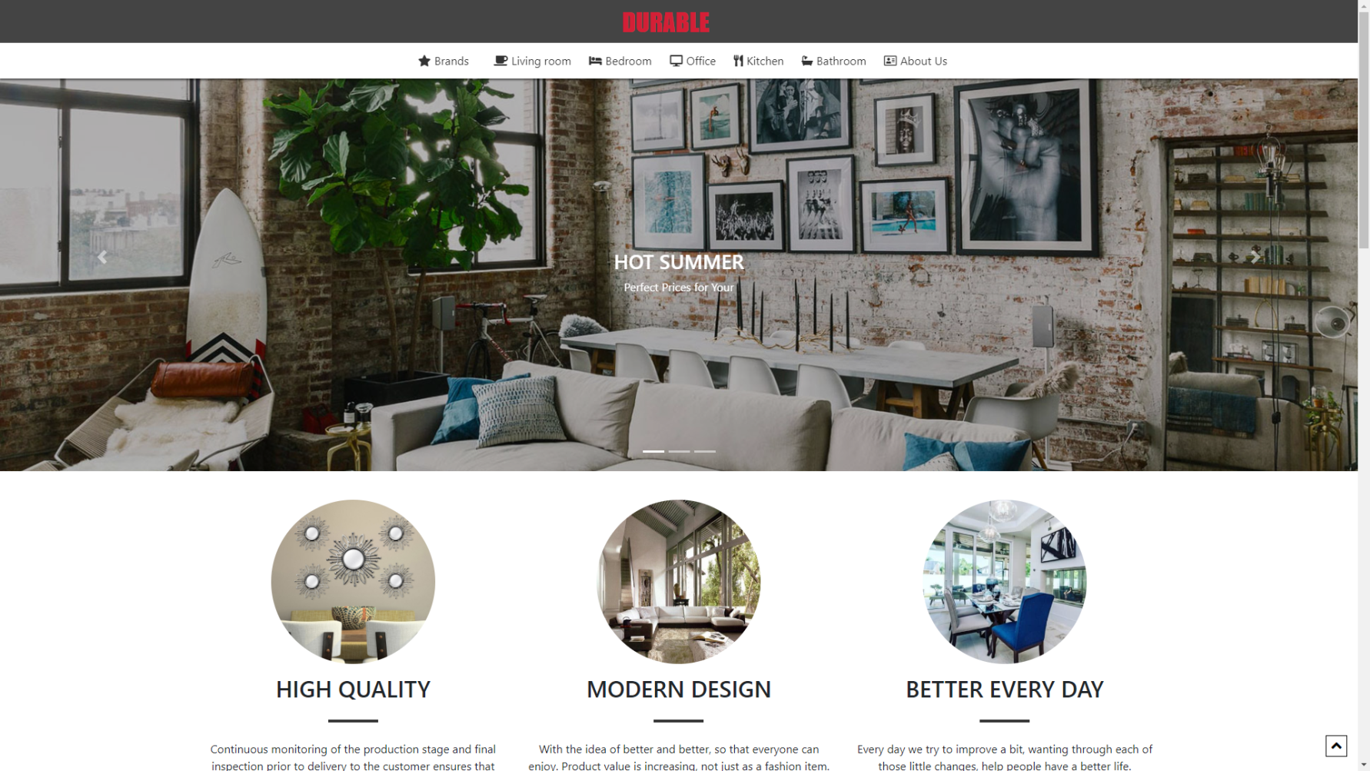
Home page

Slide 7
All Brands Page
Show all the products of the brands and display them according to the furniture you choose.
When you choose the furniture by brand will display according to what you choose
In the product card, if you hover product card, the button will be displayed
When clicked download button, you will download the product details file.
When clicked compare and choose product, it will compare the products you choose.

Slide 8
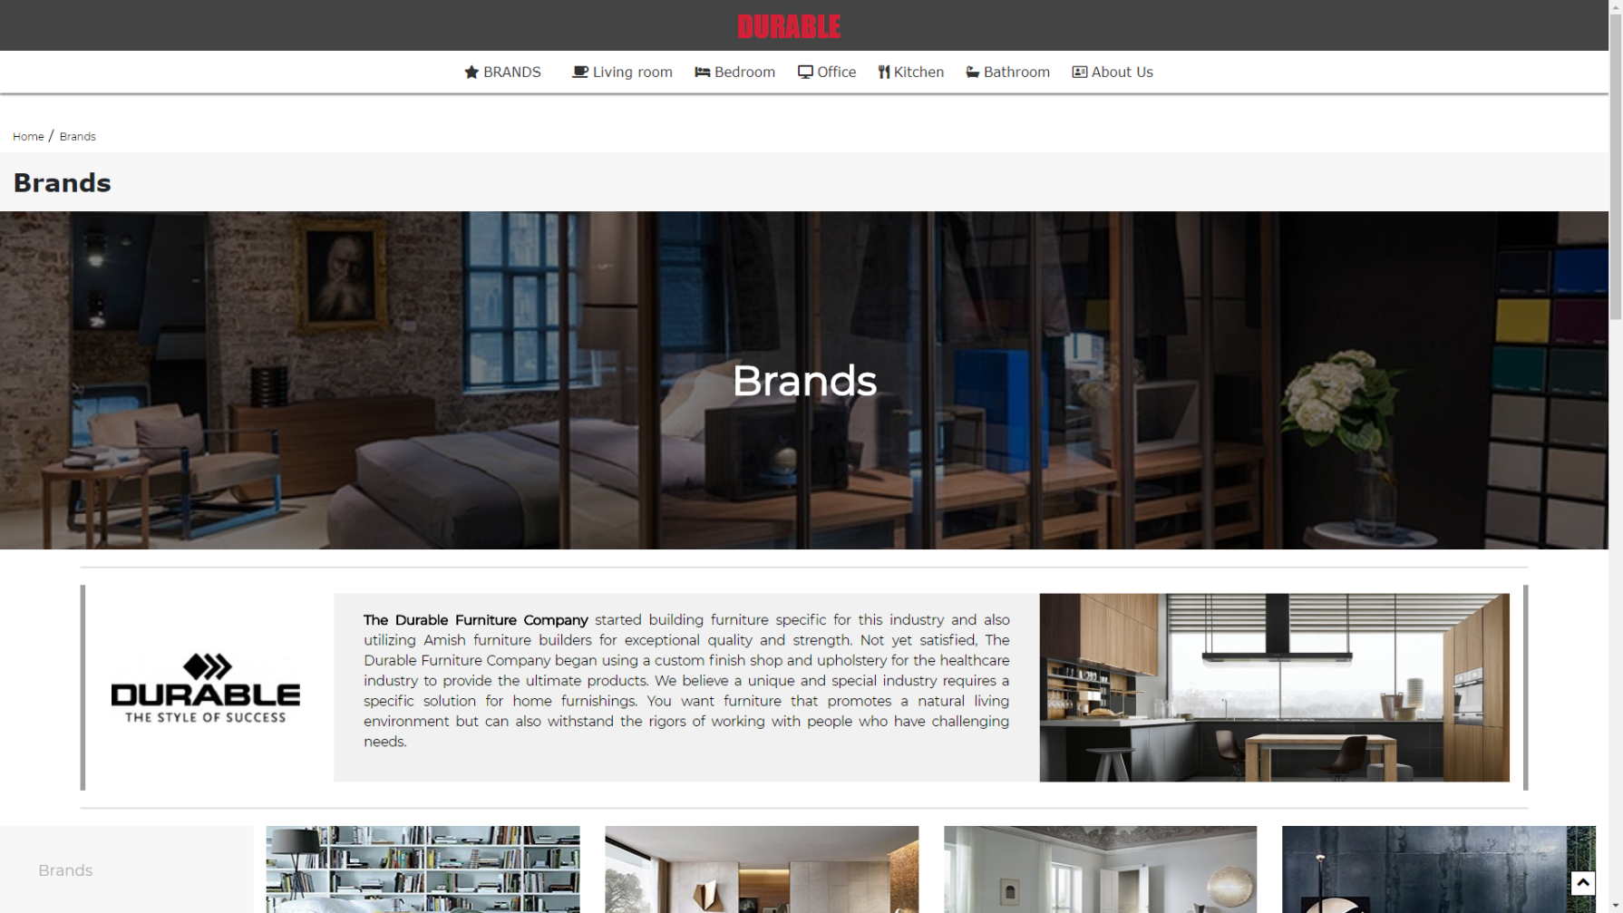
All brands page

Slide 9
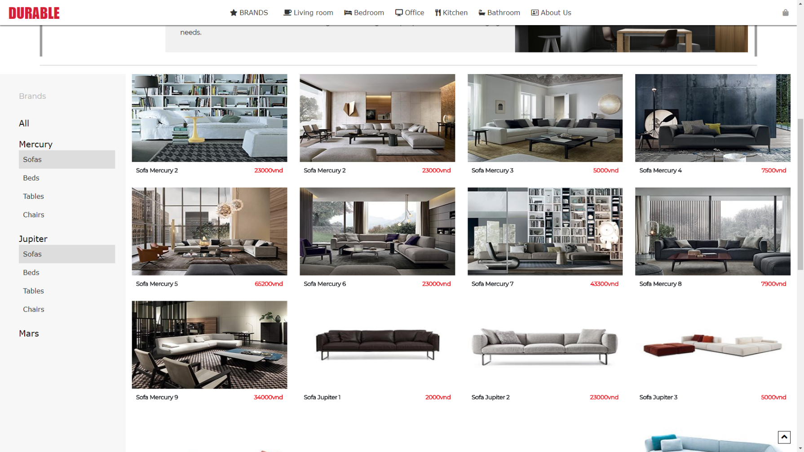
All brands page

Slide 10
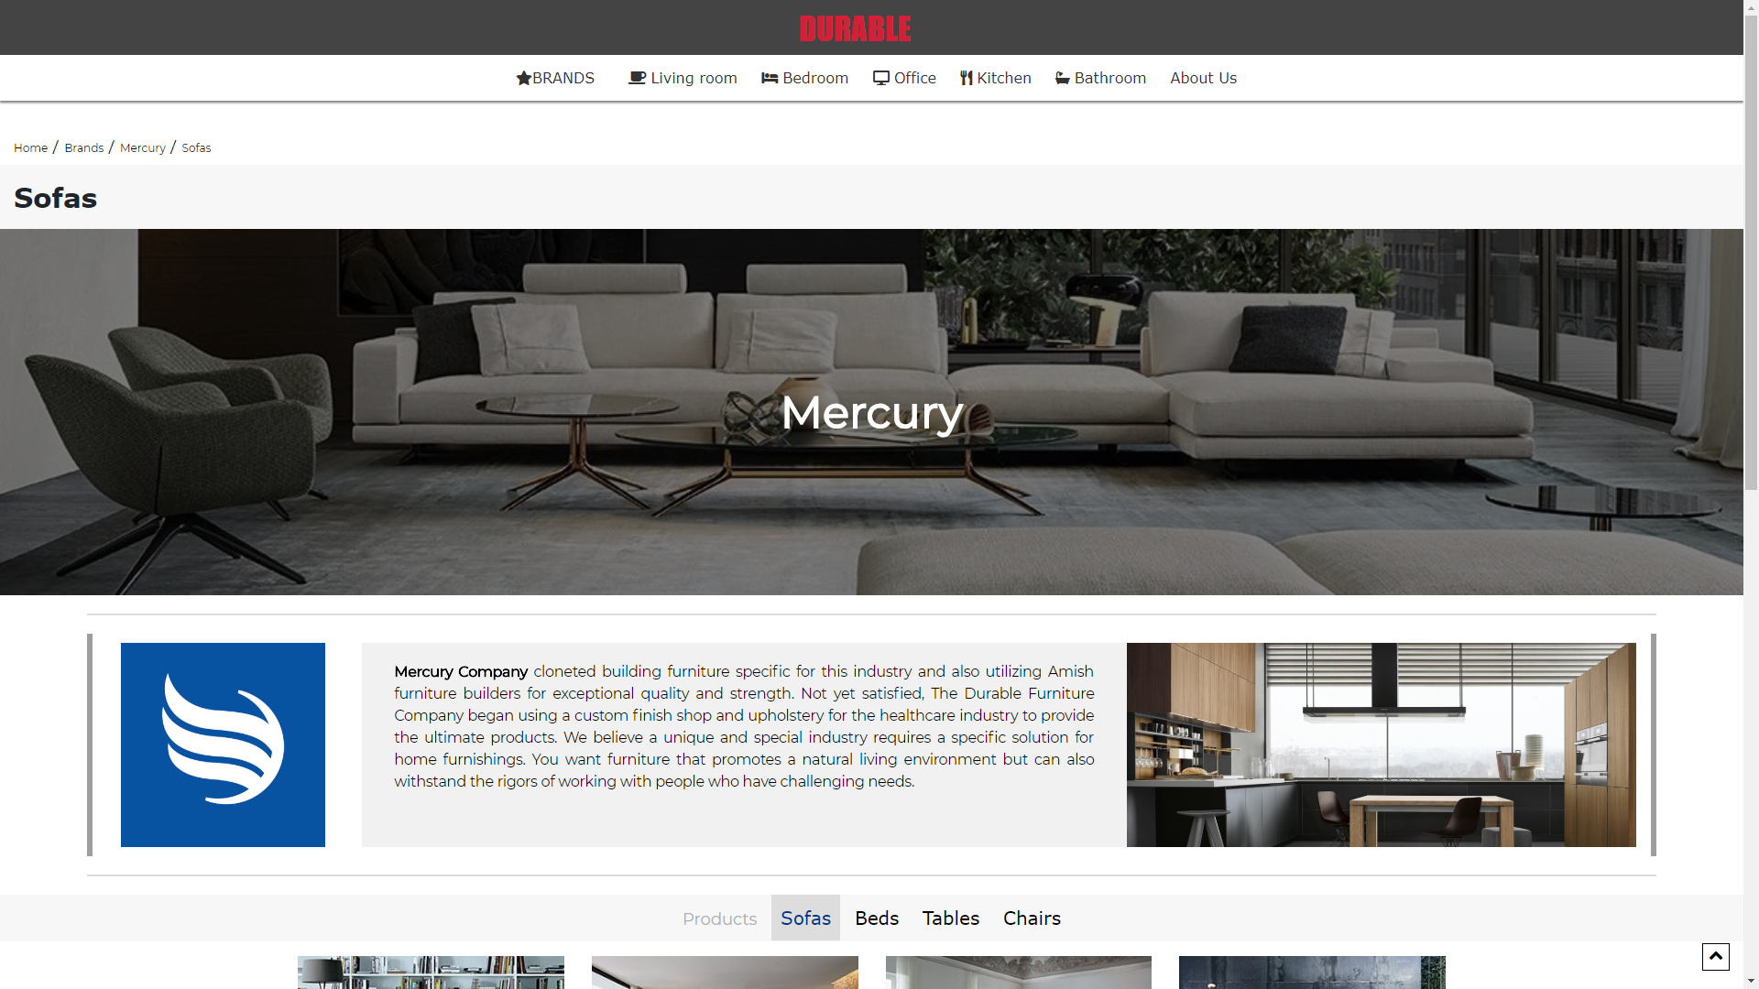
Brands Page
This page shows all products of a brand. You can choose the type of furniture you want see. (Eg: Mercury, Mars,..)

Slide 11
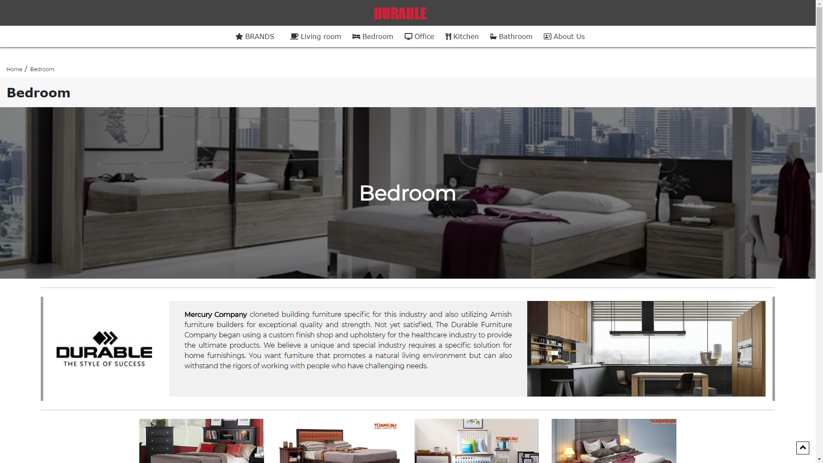
Rooms Page
This page shows all the products of a room. (Eg:living room,office,..)

Slide 12
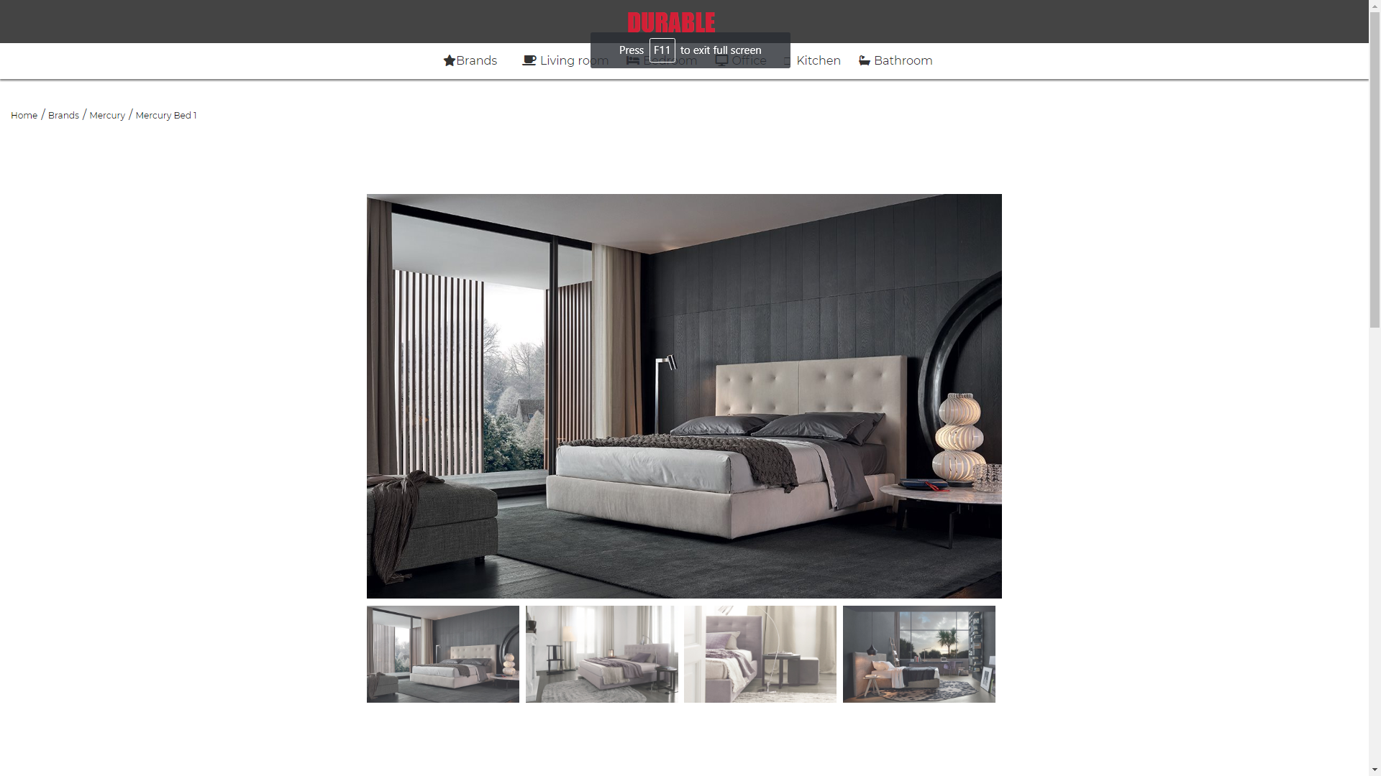
Product details Page
This page show information of product
Photo slide show
Information

Slide 13
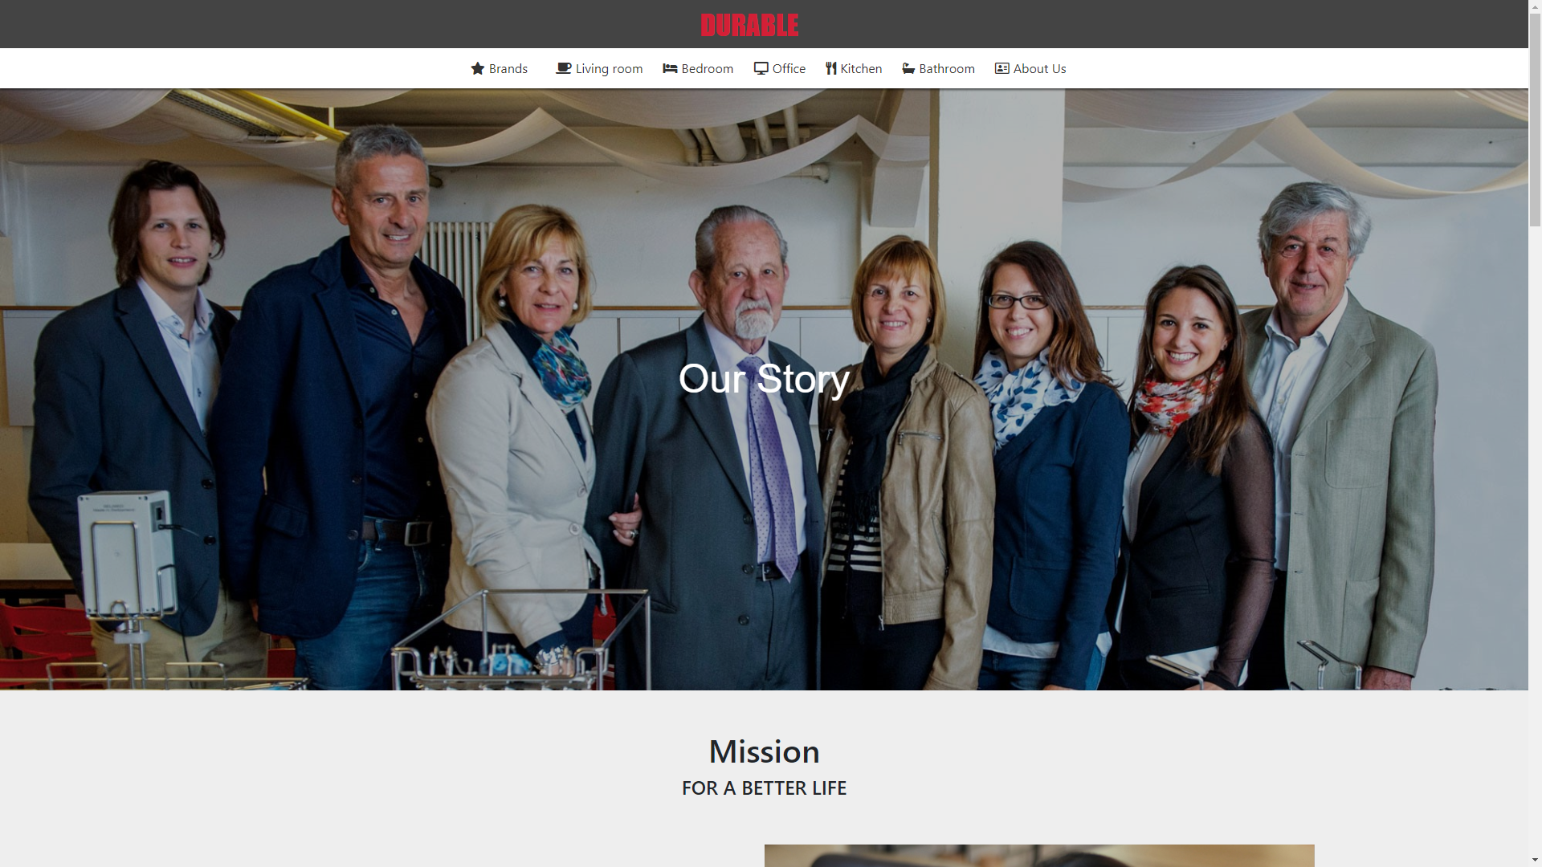
Our Story Page
This page shows shop information with effect.

Slide 14
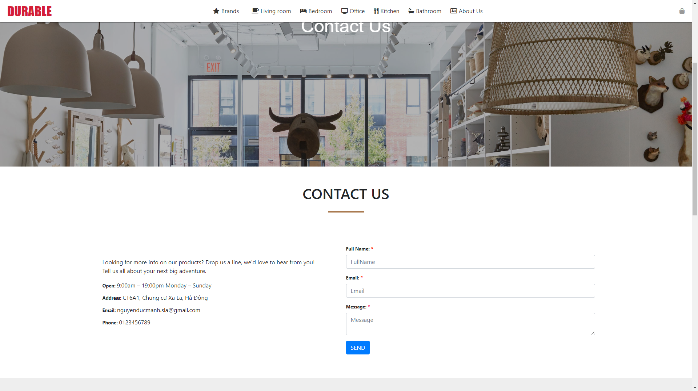
CONTACT US
This page help parents feedback about the content of the site as well as providing feedback to developers
Contact phone number
Company Address (Google Map)
Contact Email
Dialog box to send the message

